Slide 1
CSE 207: Data Structures and Algorithms-II (Part 1)
Instructor
Dr Md Monirul Islam

Slide 2
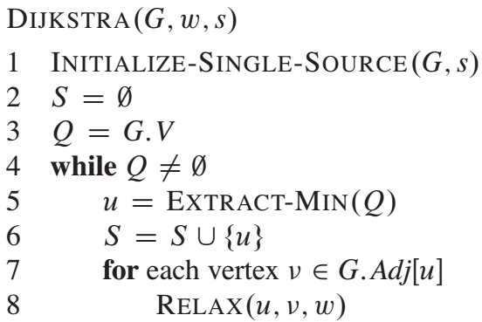
Dijkstra Algorithm for SSSP
Very similar to Prim’s Algorithm or BFS
S stores the vertices whose ds are fixed
The algorithm maintains the invariant that Q = V-S at the start of each iteration of the while loop of lines 4-8.

Slide 3
Simulation of Dijkstra Algorithm
t
x
1
∞
∞
10
s
9
2
3
4
0
6
5
7
∞
2
∞
y
z
Initialization

Slide 4
Simulation of Dijkstra Algorithm
t
x
t
x
1
∞
10
1
∞
∞
10
10
s
s
9
9
2
3
2
3
4
4
6
0
6
0
7
5
7
5
∞
2
∞
5
2
∞
y
z
y
z
Initialization
Step 1

Slide 5
Simulation of Dijkstra Algorithm
t
x
t
x
t
x
1
∞
10
1
∞
8
1
14
∞
10
10
10
s
s
s
9
9
9
2
3
2
3
4
2
3
4
6
6
0
4
0
0
6
7
5
7
7
5
5
∞
2
∞
5
2
∞
5
2
7
y
z
y
z
y
z
Initialization
Step 1
Step 2

Slide 6
Simulation of Dijkstra Algorithm
t
x
t
x
8
1
14
8
1
13
10
10
s
s
9
9
2
3
2
3
4
4
0
6
0
6
7
5
7
5
5
2
7
5
2
7
y
z
y
z
Step 2
Step 3

Slide 7
Simulation of Dijkstra Algorithm
t
x
t
x
t
x
8
1
14
8
1
13
8
1
9
10
10
10
s
s
s
9
9
9
2
3
2
3
2
3
4
4
6
4
0
6
0
0
6
7
7
5
7
5
5
5
2
7
5
2
7
5
2
7
y
z
y
z
y
z
Step 2
Step 3
Step 4

Slide 8
Simulation of Dijkstra Algorithm
t
x
t
x
t
x
8
1
13
8
1
9
8
1
9
10
10
10
s
s
s
9
9
9
2
3
2
3
2
3
4
4
6
4
0
6
0
0
6
7
7
5
7
5
5
5
2
7
5
2
7
5
2
7
y
z
y
z
y
z
Step 3
Step 4
Step 5

Slide 9
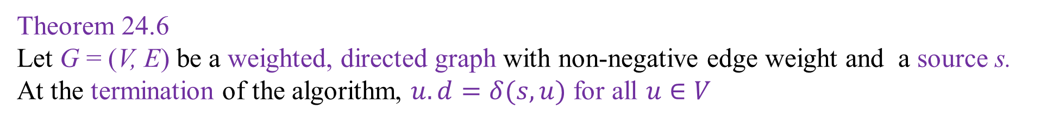
Correctness of Dijkstra Algorithm
Theorem 24.6
Let G = (V, E) be a weighted, directed graph with non-negative edge weight and a source s.
At the termination of the algorithm, $u.d=δ(s,u)$ for all $u∈V$

Slide 10
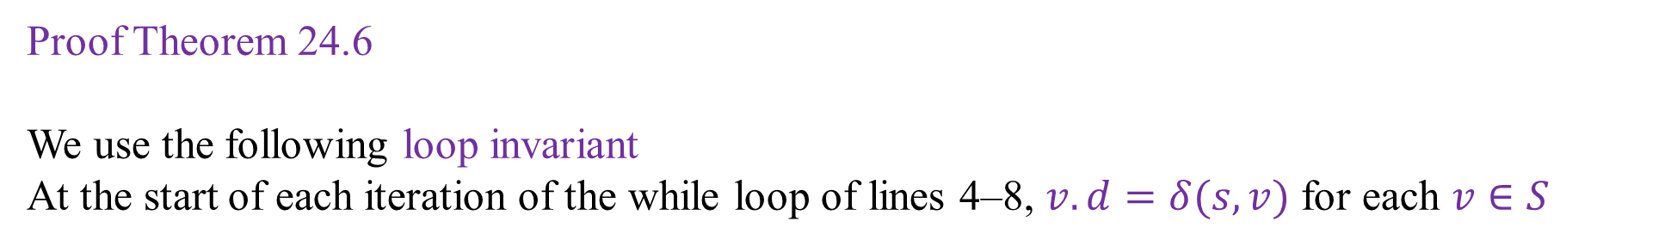
Correctness of Dijkstra Algorithm
Proof Theorem 24.6
We use the following loop invariant
At the start of each iteration of the while loop of lines 4–8, $v.d=δ(s,v)$ for each $v∈S$

Slide 11
Correctness of Dijkstra Algorithm
Proof Theorem 24.6
We use the following loop invariant
At the start of each iteration of the while loop of lines 4–8, $v.d=δ(s,v)$ for each $v∈S$
t
x
t
x
1
1
8
9
8
14
10
10
s
s
9
9
2
3
4
0
6
2
3
4
0
6
5
7
5
7
5
2
7
5
2
7
y
z
y
z
Intermediate
Final

Slide 12
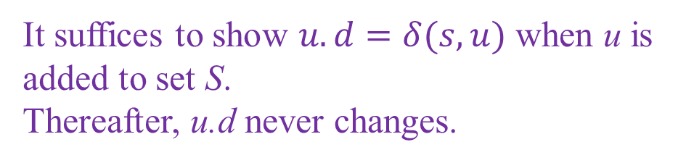
Correctness of Dijkstra Algorithm
Proof Theorem 24.6
We use the following loop invariant
At the start of each iteration of the while loop of lines 4–8, $v.d=δ(s,v)$ for each $v∈S$
t
x
1
14
8
It suffices to show $u.d=δ(s,u)$ when u is added to set S.
Thereafter, u.d never changes.
10
s
9
2
3
4
0
6
5
7
5
2
7
y
z
Intermediate

Slide 13
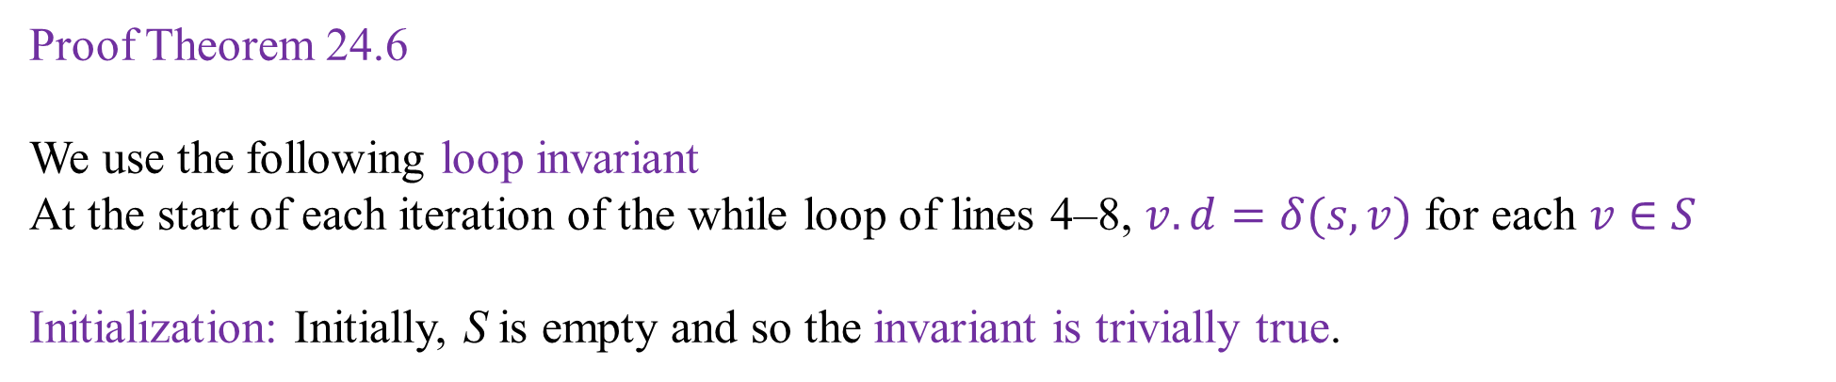
Correctness of Dijkstra Algorithm
Proof Theorem 24.6
We use the following loop invariant
At the start of each iteration of the while loop of lines 4–8, $v.d=δ(s,v)$ for each $v∈S$
Initialization: Initially, S is empty and so the invariant is trivially true.

Slide 14
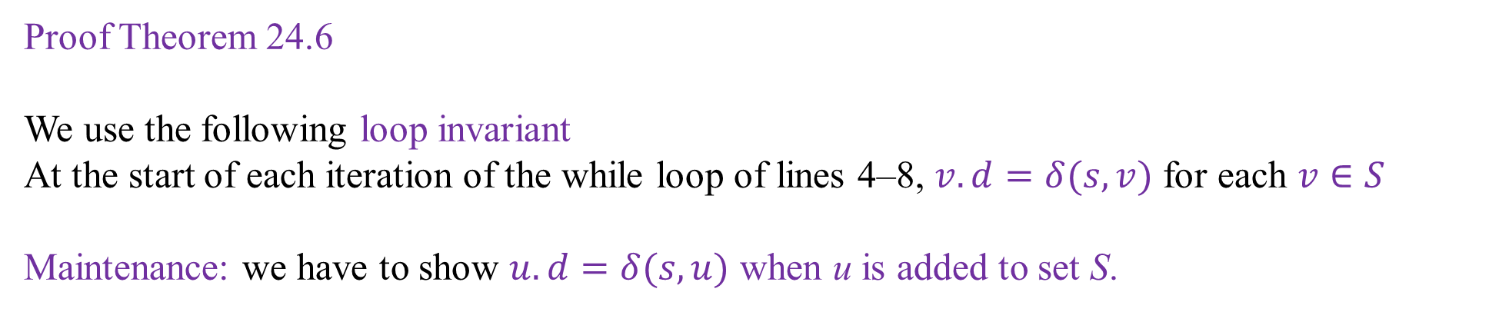
Correctness of Dijkstra Algorithm
Proof Theorem 24.6
We use the following loop invariant
At the start of each iteration of the while loop of lines 4–8, $v.d=δ(s,v)$ for each $v∈S$
Maintenance: we have to show $u.d=δ(s,u)$ when u is added to set S.

Slide 15
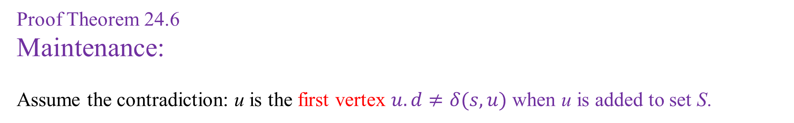
Correctness of Dijkstra Algorithm
Proof Theorem 24.6
Maintenance:
Assume the contradiction: u is the first vertex $u.d≠δ(s,u)$ when u is added to set S.

Slide 16
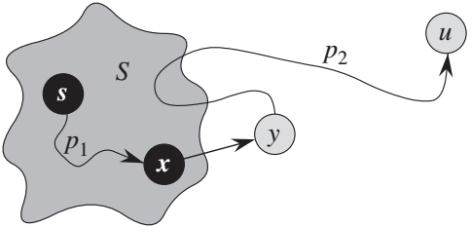
Correctness of Dijkstra Algorithm
Proof Theorem 24.6
Maintenance:
Assume the contradiction: u is the first vertex $u.d≠δ(s,u)$ when u is added to set S.
n
S
m

Slide 17
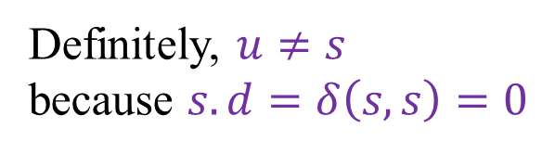
Correctness of Dijkstra Algorithm
Proof Theorem 24.6
Maintenance:
Assume the contradiction: u is the first vertex $u.d≠δ(s,u)$ when u is added to set S.
Definitely, $u≠s$
because $s.d=δ\left(s,s\right)=0$
n
S
m

Slide 18
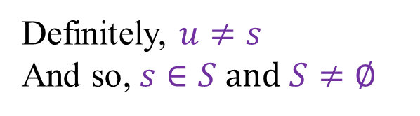
Correctness of Dijkstra Algorithm
Proof Theorem 24.6
Maintenance:
Assume the contradiction: u is the first vertex $u.d≠δ(s,u)$ when u is added to set S.
Definitely, $u≠s$
And so, $s∈S and S≠∅$
n
m

Slide 19
Correctness of Dijkstra Algorithm
Proof Theorem 24.6
Maintenance:
Assume the contradiction: u is the first vertex $u.d≠δ(s,u)$ when u is added to set S.
We must have a path from s to u
n
m

Slide 20

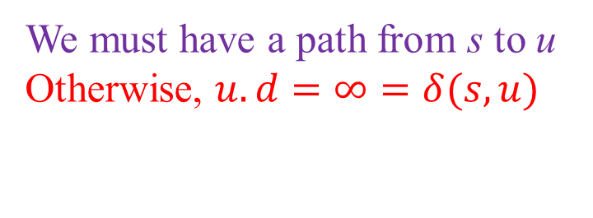
Correctness of Dijkstra Algorithm
Proof Theorem 24.6
Maintenance:
Assume the contradiction: u is the first vertex $u.d≠δ(s,u)$ when u is added to set S.
We must have a path from s to u
Otherwise, $u.d=∞=δ(s,u)$
X
n
$$δ\left(s,u\right)=∞$$
m

Slide 21
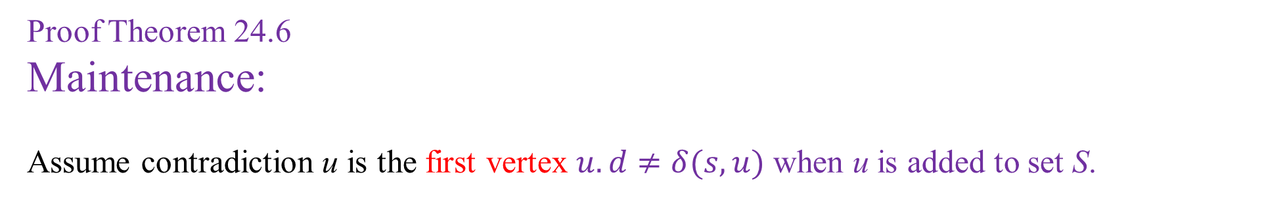
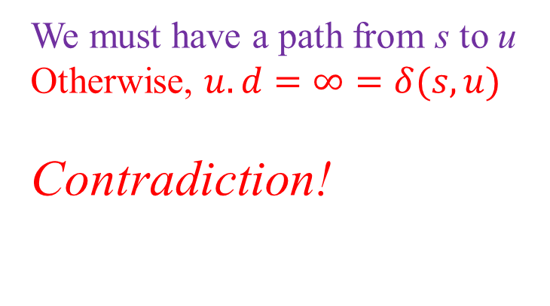
Correctness of Dijkstra Algorithm
Proof Theorem 24.6
Maintenance:
Assume contradiction u is the first vertex $u.d≠δ(s,u)$ when u is added to set S.
We must have a path from s to u
Otherwise, $u.d=∞=δ(s,u)$
Contradiction!
X
n
$$δ\left(s,u\right)=∞$$
m

Slide 22
Correctness of Dijkstra Algorithm
Proof Theorem 24.6
Maintenance:
Assume contradiction u is the first vertex $u.d≠δ(s,u)$ when u is added to set S.
We must have a path from s to u
AND, there must be a shortest path p from s to u
shortest path
p
n
m

Slide 23

Correctness of Dijkstra Algorithm
Proof Theorem 24.6
Maintenance:
Assume contradiction u is the first vertex $u.d≠δ(s,u)$ when u is added to set S.
Shortest path p connects $s∈S$ to $u∈V−S$
shortest path
p
n
m

Slide 24
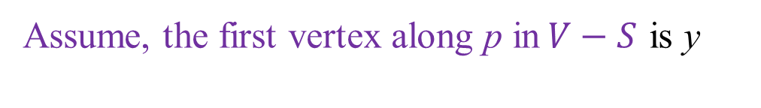
Correctness of Dijkstra Algorithm
Proof Theorem 24.6
Maintenance:
Assume contradiction u is the first vertex $u.d≠δ(s,u)$ when u is added to set S.
Assume, the first vertex along p in$V−S$ is y
shortest path
p
n
m

Slide 25
Correctness of Dijkstra Algorithm
Proof Theorem 24.6
Maintenance:
Assume contradiction u is the first vertex $u.d≠δ(s,u)$ when u is added to set S.
y’s immediate predecessor in S is x
shortest path
p
n
m

Slide 26

Correctness of Dijkstra Algorithm
Proof Theorem 24.6
Maintenance:
Assume contradiction u is the first vertex $u.d≠δ(s,u)$ when u is added to set S.
p is decomposed into p₁ and p₂
p
n
p:
m

Slide 27

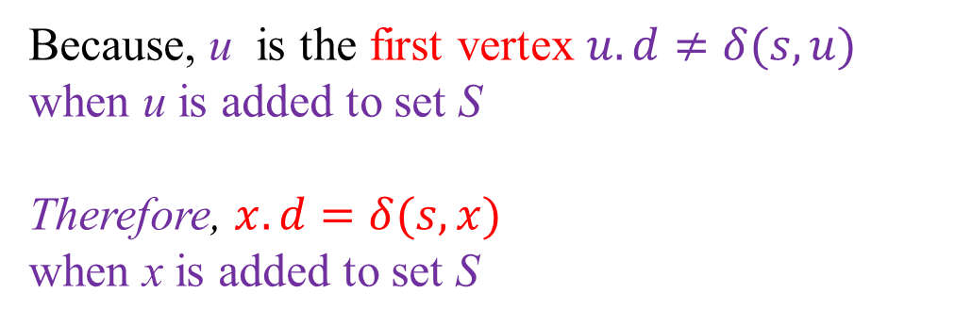
Correctness of Dijkstra Algorithm
Proof Theorem 24.6
Maintenance:
Assume contradiction u is the first vertex $u.d≠δ(s,u)$ when u is added to set S.
Because, u is the first vertex $u.d≠δ(s,u)$ when u is added to set S
Therefore, $x.d=δ(s,x)$
when x is added to set S
p
n
m
$$x.d=δ(s,x)$$

Slide 28


Correctness of Dijkstra Algorithm
Proof Theorem 24.6
Maintenance:
Assume contradiction u is the first vertex $u.d≠δ(s,u)$ when u is added to set S.
$x.d=δ(s,x)$ when x is added to set S
By convergence property,
$y.d=δ(s,y)$ because
y is next to x in shortest path p
p
n
m
$$x.d=δ(s,x)$$
$$y.d=δ(s,y)$$

Slide 29


Correctness of Dijkstra Algorithm
Proof Theorem 24.6
Maintenance:
Assume contradiction u is the first vertex $u.d≠δ(s,u)$ when u is added to set S.
We obtained $y.d=δ(s,y)$
p
n
m
$$y.d=δ(s,y)$$

Slide 30
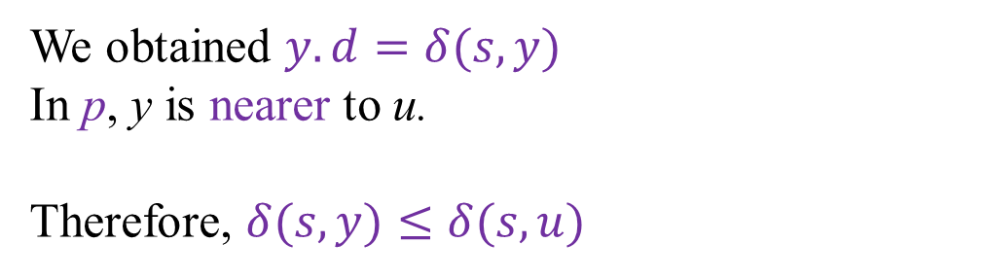
Correctness of Dijkstra Algorithm
Proof Theorem 24.6
Maintenance:
Assume contradiction u is the first vertex $u.d≠δ(s,u)$ when u is added to set S.
We obtained $y.d=δ(s,y)$
In p, y is nearer to u.
Therefore, $δ(s,y)≤δ(s,u)$
p
n
m
$$y.d=δ(s,y)$$

Slide 31
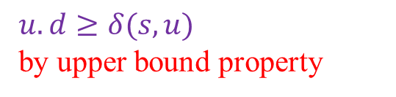
Correctness of Dijkstra Algorithm
Proof Theorem 24.6
Maintenance:
Assume contradiction u is the first vertex $u.d≠δ(s,u)$ when u is added to set S.
We obtained: $y.d=δ(s,y)$ and $δ(s,y)≤δ(s,u)$
p
n
$$u.d≥δ(s,u)$$
by upper bound property
m
$$y.d=δ(s,y)$$

Slide 32


Correctness of Dijkstra Algorithm
Proof Theorem 24.6
Maintenance:
Assume contradiction u is the first vertex $u.d≠δ(s,u)$ when u is added to set S.
We obtained: $y.d=δ(s,y)$ and $δ(s,y)≤δ(s,u)$
$$y.d=δ(s,y)$$
$≤δ(s,u)$
$≤u.d$
p
n
$$u.d≥δ(s,u)$$
m
$$y.d=δ(s,y)$$

Slide 33

Correctness of Dijkstra Algorithm
Proof Theorem 24.6
Maintenance:
Assume contradiction u is the first vertex $u.d≠δ(s,u)$ when u is added to set S.
We obtained: $y.d=δ(s,y)$ and $δ(s,y)≤δ(s,u)$
We derive $y.d≤u.d$
p
n
$$u.d≥δ(s,u)$$
m
$$y.d=δ(s,y)$$

Slide 34

Correctness of Dijkstra Algorithm
Proof Theorem 24.6
Maintenance:
Assume contradiction u is the first vertex $u.d≠δ(s,u)$ when u is added to set S.
We obtained: $y.d=δ(s,y)$ and $δ(s,y)≤δ(s,u)$
We derive $y.d≤u.d$
But both y and u were in V-S
And we choose u instead of y
p
n
$$u.d≥δ(s,u)$$
m
$$y.d=δ(s,y)$$

Slide 35

Correctness of Dijkstra Algorithm
Proof Theorem 24.6
Maintenance:
Assume contradiction u is the first vertex $u.d≠δ(s,u)$ when u is added to set S.
We obtained: $y.d=δ(s,y)$ and $δ(s,y)≤δ(s,u)$
We derive $y.d≤u.d$
But both y and u were in V-S
And we choose u instead of y
Therefore, $u.d≤y.d$
p
n
$$u.d≥δ(s,u)$$
m
$$y.d=δ(s,y)$$

Slide 36
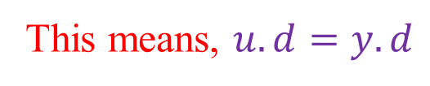
Correctness of Dijkstra Algorithm
Proof Theorem 24.6
Maintenance:
Assume contradiction u is the first vertex $u.d≠δ(s,u)$ when u is added to set S.
We obtained: $y.d=δ(s,y)$ and $δ(s,y)≤δ(s,u)$
We derive $y.d≤u.d$
But both y and u were in V-S
And we choose u instead of y
Therefore, $u.d≤y.d$
p
n
$$u.d≥δ(s,u)$$
m
$$y.d=δ(s,y)$$
This means, $u.d=y.d$

Slide 37


Correctness of Dijkstra Algorithm
Proof Theorem 24.6
Maintenance:
Assume contradiction u is the first vertex $u.d≠δ(s,u)$ when u is added to set S.
We obtained: $y.d=δ(s,y)$ and $δ(s,y)≤δ(s,u)$
$$y.d=δ(s,y)$$
$≤δ(s,u)$
$≤u.d$
p
n
$$u.d≥δ(s,u)$$
m
$$y.d=δ(s,y)$$
We found, $u.d=y.d$

Slide 38

Correctness of Dijkstra Algorithm
Proof Theorem 24.6
Maintenance:
Assume contradiction u is the first vertex $u.d≠δ(s,u)$ when u is added to set S.
We obtained: $y.d=δ(s,y)$ and $δ(s,y)≤δ(s,u)$
$$y.d=δ(s,y)$$
$≤δ(s,u)$
$≤u.d$
p
n
$$u.d≥δ(s,u)$$
$$y.d=δ(s,y)$$
$=δ(s,u)$
$=u.d$
m
$$y.d=δ(s,y)$$
We found, $u.d=y.d$

Slide 39
Correctness of Dijkstra Algorithm
Proof Theorem 24.6
Maintenance:
Assume contradiction u is the first vertex $u.d≠δ(s,u)$ when u is added to set S.
We obtained: $u.d=δ\left(s,u\right)$ when u is added to set S.
p
n
$$u.d≥δ(s,u)$$
m
$$y.d=δ(s,y)$$

Slide 40
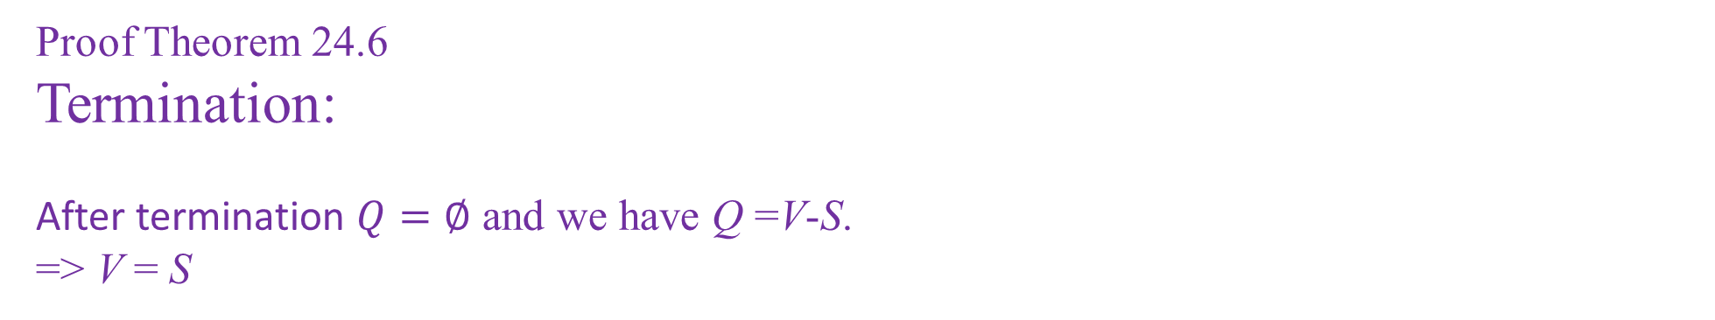
Correctness of Dijkstra Algorithm
Proof Theorem 24.6
Termination:
After termination $Q=∅$ and we have Q =V-S.
=> V = S
=> $u.d=δ\left(s,u\right)$ for all vertices u of V.
S
n
u
s
y
m
x

Slide 41
Correctness of Dijkstra Algorithm
Corollary 24.7
If we run Dijkstra’s algorithm on a weighted, directed graph G=(V, E) with nonnegative weight function w and source s,
then at termination, the predecessor subgraph G_{π} is a shortest-paths tree rooted at s.

Slide 42
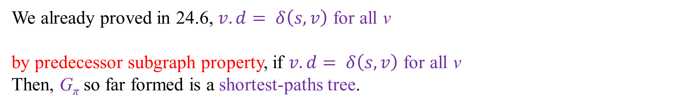
Correctness of Dijkstra Algorithm
Proof of Corollary 24.7
We already proved in 24.6, $v.d= δ\left(s, v\right)$ for all v
by predecessor subgraph property, if $v.d= δ\left(s, v\right)$ for all v
Then, G_{π} so far formed is a shortest-paths tree.

Slide 43



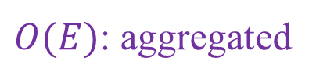

Complexity of Dijkstra Algorithm
$$O(V)$$
$$O(1)$$
Queue operation
$$O(V)$$
Queue operation
$$O(1)$$
$O(E)$: aggregated
Queue operation

Slide 44
Complexity of Dijkstra Algorithm
$$O(V)$$
$$O(1)$$
Queue operation
$$O(V)$$
Queue operation
$$O(1)$$
$O(E)$: aggregated
Queue operation
Complexity depends on implementation of queue operations

Slide 45




Complexity of Dijkstra Algorithm
$$O(V)$$
$$O(1)$$
$$O(V)$$
$$O(V)$$
$$O(V)$$
$$O(1)$$
$O(E)$: aggregated
$$O(1)$$
Assume simple array implementation: $O(E+V^{2})$ = $O(V^{2})$

Slide 46


Complexity of Dijkstra Algorithm
$$O(V)$$
$$O(1)$$
$$O(V)$$
$$O(V)$$
$$O(lgV)$$
$$O(1)$$
$O(E)$: aggregated
$$O(lgV)$$
Assume min-priority queue implementation: $O(ElgV+VlgV)$= $O(ElgV)$

Slide 47
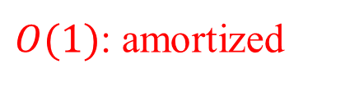
Complexity of Dijkstra Algorithm
$$O(V)$$
$$O(1)$$
$$O(V)$$
$$O(V)$$
$$O(lgV)$$
$$O(1)$$
$O(E)$: aggregated
$O(1)$: amortized
Assume Fibonacci based min-priority queue implementation: $O(E+VlgV)$

Slide 48
Properties of Shortest Paths and Relaxation
Necessary properties for the correctness proof of SSSP algorithms
Triangle inequality (Lemma 24.10)
Upper-bound property (Lemma 24.11)
No-path property (Corollary 24.12)
Convergence property (Lemma 24.14)
Path-relaxation property (Lemma 24.15)
Predecessor-subgraph property (Lemma 24.17)
Property 2-6 assume that
Graph initialization is done
Relaxation is the only way to update the predecessor graph, e.g., shortest paths tree

Slide 49
Triangle Inequality
For any edge $(u,v)∈E$, we have $δ\left(s,v\right)≤δ\left(s,u\right)+w(u,v)$
s
$$δ\left(s,u\right)$$
$$w(u,v)$$
$$δ\left(s,v\right)$$
u
v

Slide 50
Upper-bound Property
We always have $v.d≥ δ\left(s,v\right)$for all vertices $v∈V$, and once v.d achieves the value $δ\left(s,v\right)$, it never changes.
v.d achieves $δ\left(s,v\right)$ through this path
s
$$δ\left(s,u\right)$$
$$w(u,v)$$
$$δ\left(s,v\right)$$
u
v
This relaxation does nothing

Slide 51
No-path Property
If there is no path from s to v, then we always have $v.d= δ\left(s,v\right)=∞$
×
s
v
w
δ(s, v) = ∞
δ(s, w) = finite

Slide 52
Convergence Property
If $s↝u→v$ is a shortest path in G for some $u,v∈V$, and
if $u.d= δ\left(s,u\right)$ at any time prior to relaxing edge (u, v),
then $v.d= δ\left(s,v\right)$ at all times afterward.
s
u.d = δ(s, u)
v.d = δ(s,v)
u
v

Slide 53
Path-relaxation Property
If p = <v₀, v₁, . . ., v_{k} > is a shortest path from s = v₀ to v_{k} , and
We relax edges in the order (v₀, v₁), (v₁, v₂), . . ., (v_{k-1}, v_{k})
then, $v_{k}.d= δ\left(s,v_{k}\right)$
v₀
v₁
v₂
v₃
v_{k-1}
v_{k}
0
0
0
0
0
0
Relaxation
Step 1
Relaxation
Step 2
Relaxation
Step 3
Relaxation
Step k

Slide 54
Path-relaxation Property
If p = <v₀, v₁, . . ., v_{k} > is a shortest path from s = v₀ to v_{k} , and
We relax edges in the order (v₀, v₁), (v₁, v₂), . . ., (v_{k-1}, v_{k})
then, $v_{k}.d= δ\left(s,v_{k}\right)$
After kth step
$v_{k}.d= δ\left(s,v_{k}\right)$
v₀
v₁
v₂
v₃
v_{k-1}
v_{k}
0
0
0
0
0
0
Relaxation
Step 1
Relaxation
Step 2
Relaxation
Step 3
Relaxation
Step k

Slide 55
Path-relaxation Property
If p = <v₀, v₁, . . ., v_{k} > is a shortest path from s = v₀ to v_{k} , and
We relax edges in the order (v₀, v₁), (v₁, v₂), . . ., (v_{k-1}, v_{k})
then, $v_{k}.d= δ\left(s,v_{k}\right)$
This property holds regardless of any other relaxation steps that occur, even if
they are intermixed with relaxations of the edges of p.
After kth step
$v_{k}.d= δ\left(s,v_{k}\right)$
v₀
v₁
v₂
v₃
v_{k-1}
v_{k}
0
0
0
0
0
0
Relaxation
Step 1
Relaxation
Step 2
Relaxation
Step 3
Relaxation
Step k

Slide 56
Path-relaxation Property
This property holds regardless of any other relaxation steps that occur, even if
they are intermixed with relaxations of the edges of p.
x
Step 3, 8
y
After 2kth step
$v_{k}.d= δ\left(s,v_{k}\right)$
0
0
Step 5
Step 1
Step 6, k
v₀
v₁
v₂
v₃
v_{k-1}
v_{k}
0
0
0
0
0
0
Step 2, 9
Step 4, 10
Step 7,11
Step 2k

Slide 57
Predecessor-subgraph Property
Once $v.d= δ\left(s,v\right)$ for all $v∈V$,
the predecessor subgraph is a shortest-paths tree rooted at s.
t
x
6
t
x
3
9
6
3
9
3
s
3
4
s
0
2
1
2
7
0
5
3
6
5
5
11
6
5
11
y
z
y
z
G =(V, E)
Predecessor subgraph, $G′=(V′,E′)$ or Shortest paths tree rooted at s

Slide 58
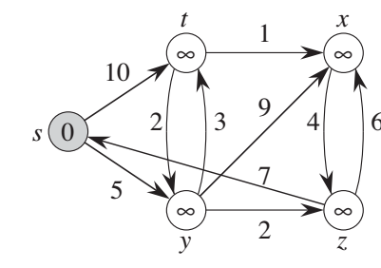
t
x
1
∞
∞
10
s
9
2
3
4
0
6
5
7
∞
2
∞
y
z
∞

Slide 59
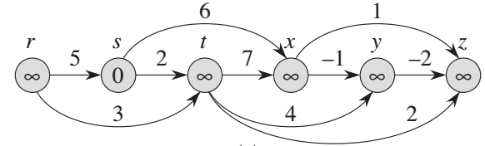
t
x
r
3
7
9
0
3
5
2
6
2
-1
0
4
1
s
3
6
1
r
s
t
x
y
z
5
11
5
2
7
-1
-2
-2
0
3
0
0
3
0
y
z
3
4
2

Slide 60
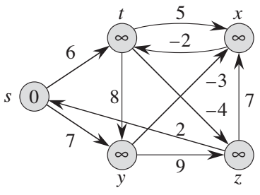
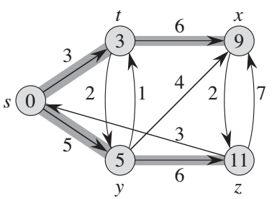
t
x
h
i
t
x
2
6
9
∞
∞
6
9
3
3
3
-8
3
3
s
∞
s
4
0
j
0
2
1
2
7
3
5
5
5
6
11
5
6
11
y
z
y
z

Slide 61
t
x
h
i
t
5
x
2
6
9
∞
∞
∞
3
∞
-2
3
-8
3
6
s
∞
s
8
-3
0
j
0
7
-4
2
5
7
5
6
11
∞
∞
9
y
z
y
z

Slide 62
End of Slides

Slide 63
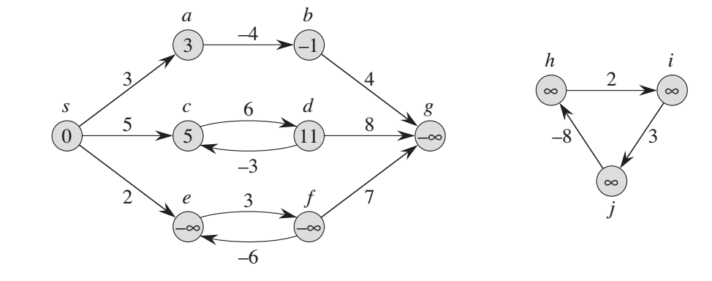
Negative Weight Edges

Slide 64
a
b
-4
-1
3
4
3
s
c
6
d
g
h
i
5
8
2
0
5
11
- ∞
∞
∞
-3
3
2
f
-8
e
3
7
∞
- ∞
- ∞
j
-6

Slide 65
a
b
-4
3
-1
4
3
s
c
6
d
g
h
i
5
8
∞
2
∞
0
5
11
- ∞
-3
3
-8
2
e
3
f
7
∞
- ∞
- ∞
j
-6

